Slide 1

Global covid-19 vaccination progress
An advanced exploratory analysis
Data analyst: Marilize de villiers

Slide 2

Overview context purpose
The COVID-19 pandemic has been in the news since the beginning of 2020, and I have been interested in how countries are affected and how they are progressing with the COVID-19 vaccination rollouts. I am also interested in which countries are using which vaccines and if the vaccines have had an effect on cases and deaths.
The data of this pandemic has been available publicly since it is a global concern.
This exploratory analysis is a personal project that forms part of the data analytics course at CareerFoundry, in which we had to find a topic and data that piques our interest.

Slide 3


Objectives & Key Questions
Build an interactive Tableau dashboard that will visually showcase well-curated results of an advanced exploratory analysis conducted in Python.
Which countries were hit the hardest with covid-19 deaths/cases?
Which countries are using which vaccines?
Which countries are more advanced with the vaccination rollouts?
How has the vaccine rollouts been progressing?
Which countries had the first batch of vaccines?
Which, if any, factors have been a driving force for vaccine rollouts in each country?

Slide 4





Data skills tools
Sourcing open data
Data wrangling & merging;
Deriving variables; Grouping & Aggregating data;
Exploratory analysis;
Geospatial analysis using a shapefile;
Regression analysis;
Cluster analysis;
Time-series analysis;
Analysis narrative
Vaccination Dataset
Population Dataset
New Combined Dataset Time Series Data
Geo Data (geojson)
Excel
Python
Tableau
GitHub

Slide 5
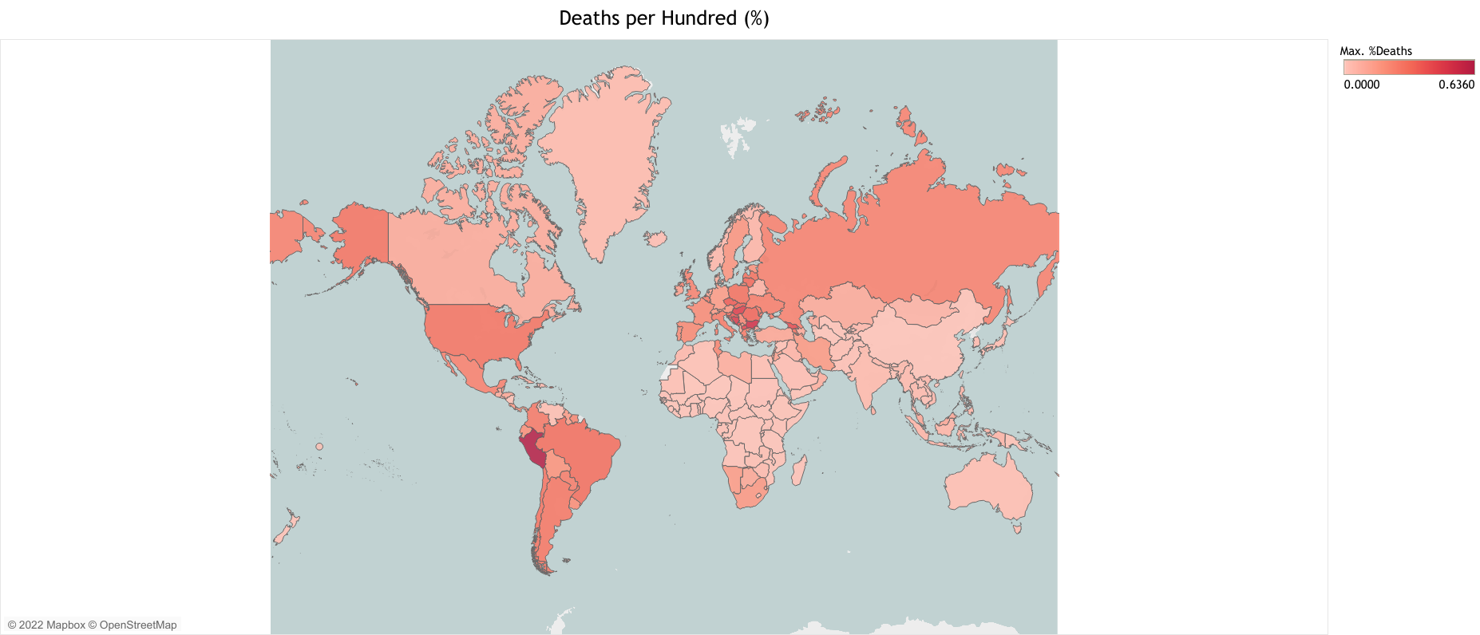
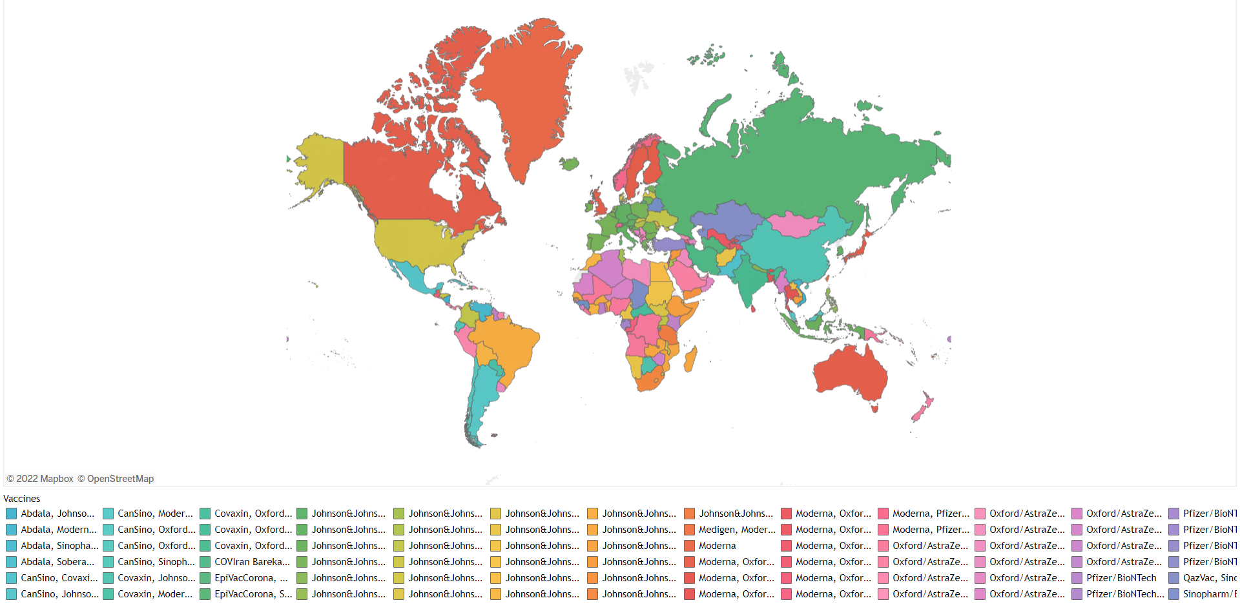

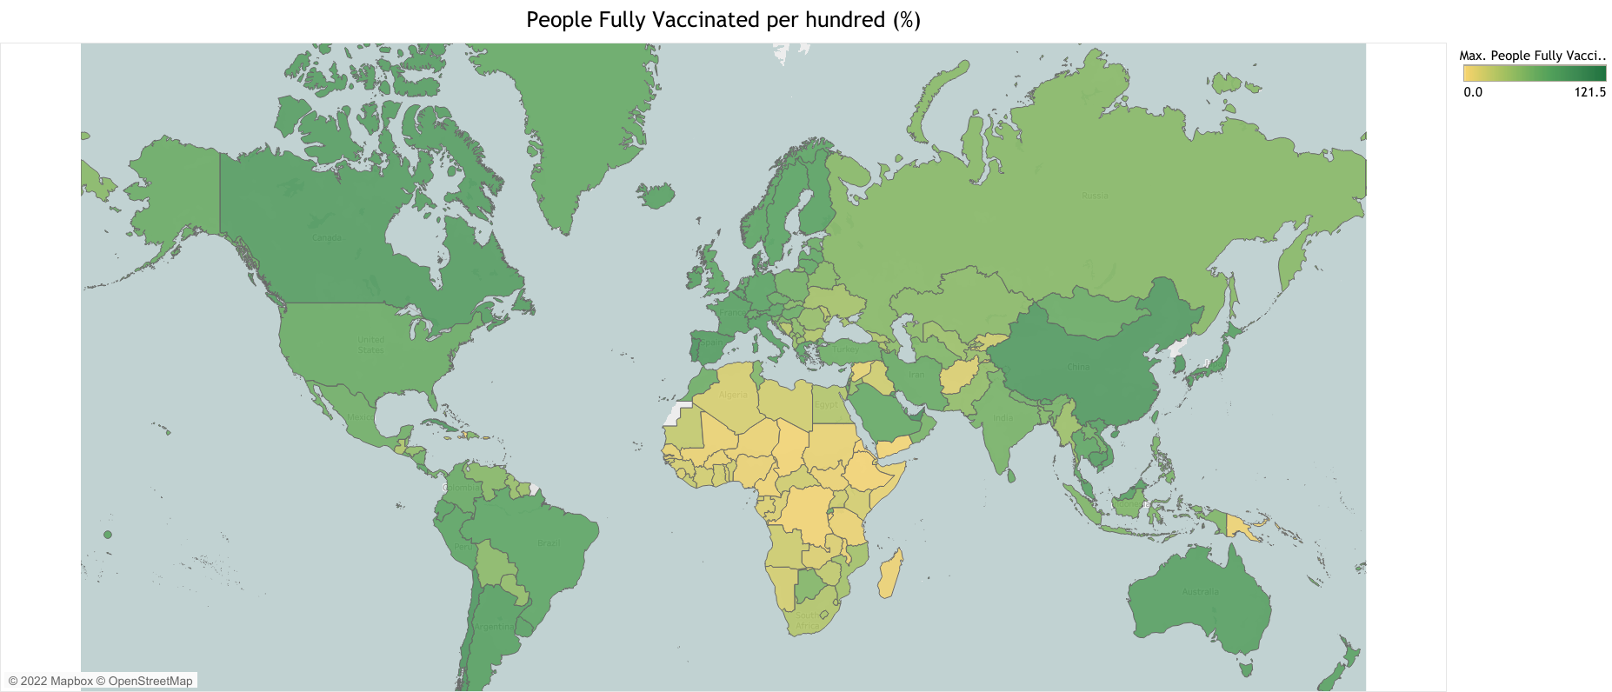
Geospatial analysis
Percentage of Deaths
Vaccines used by Countries
The darker the colour, the higher the number (more deaths and more vaccinations)
People Fully Vaccinated by 100
ANALYSIS STEPS:
I sourced open data from Kaggle.com which led me to the GitHub profile of Our World in Data where I found the dataset containing all information on COVID-19 (deaths, cases, vaccinations, types of vaccines) from the beginning of the pandemic.
I wrangled, cleaned and merged datasets in Python
Then, I did a Geospatial Analysis in Python to map which countries have the most deaths, most vaccinations, and are using which vaccines.

Slide 6

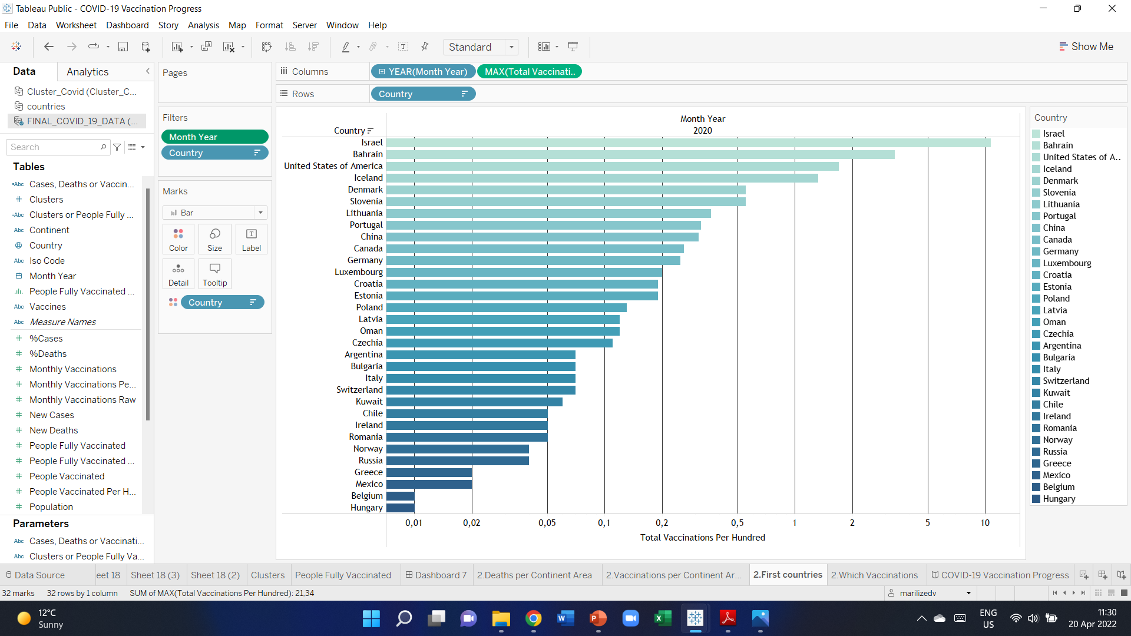
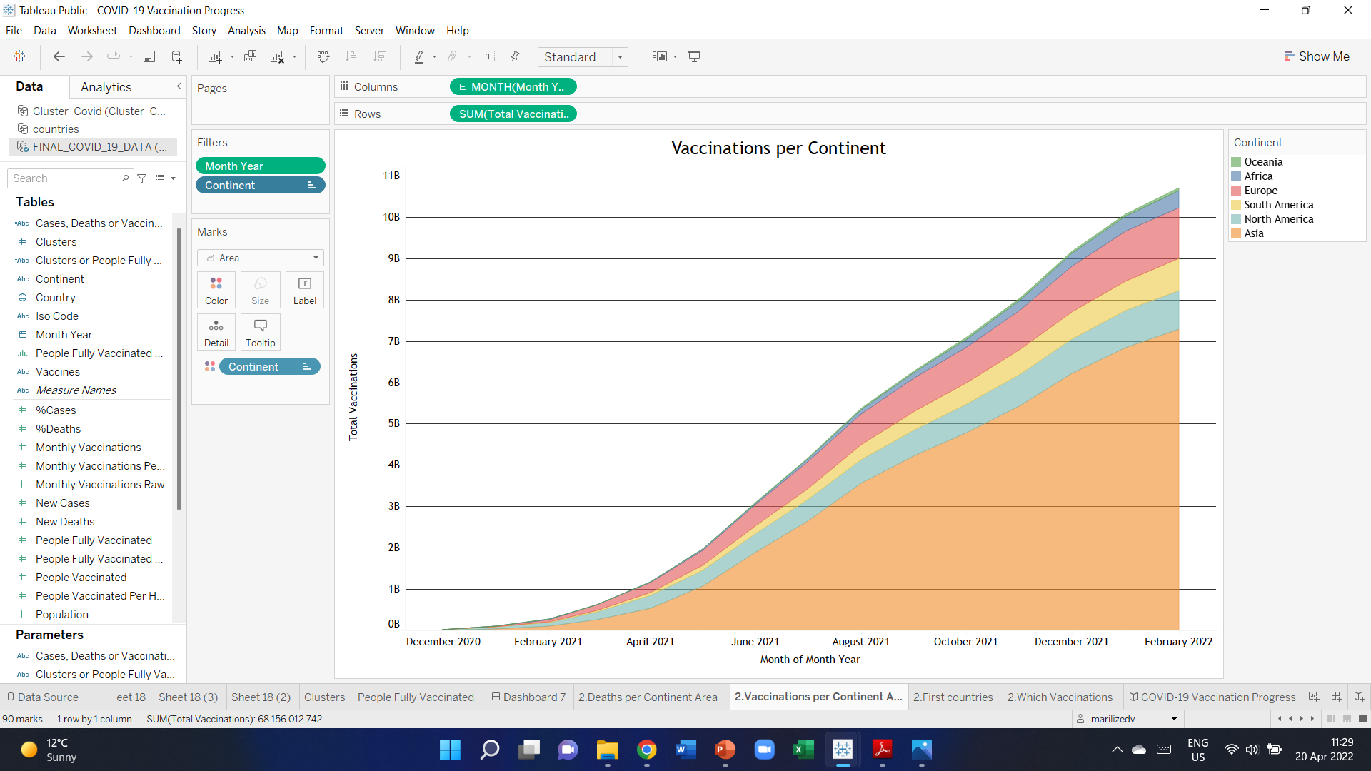
Exploratory Analysis
The bar chart shows all the countries that had the first batches of vaccines (in December 2020 already)
The line chart shows how the vaccination rollouts have progressed in each continent.

Slide 7

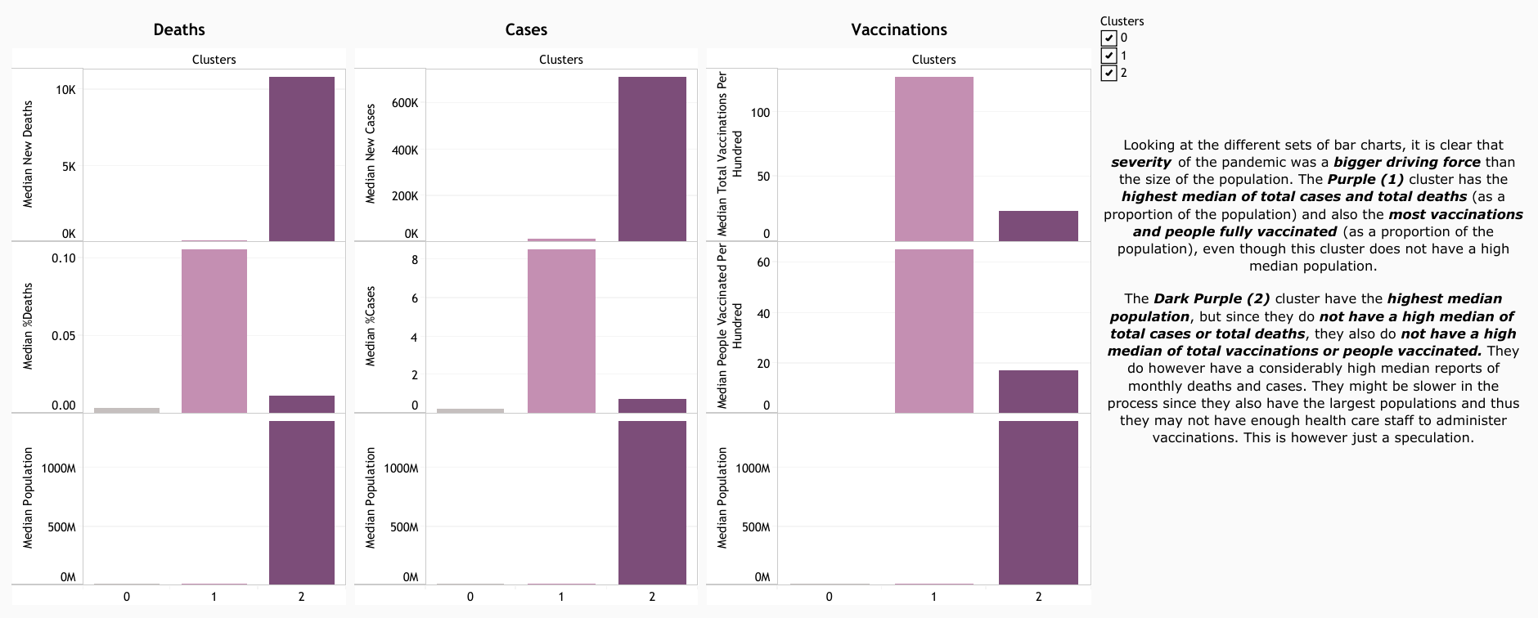
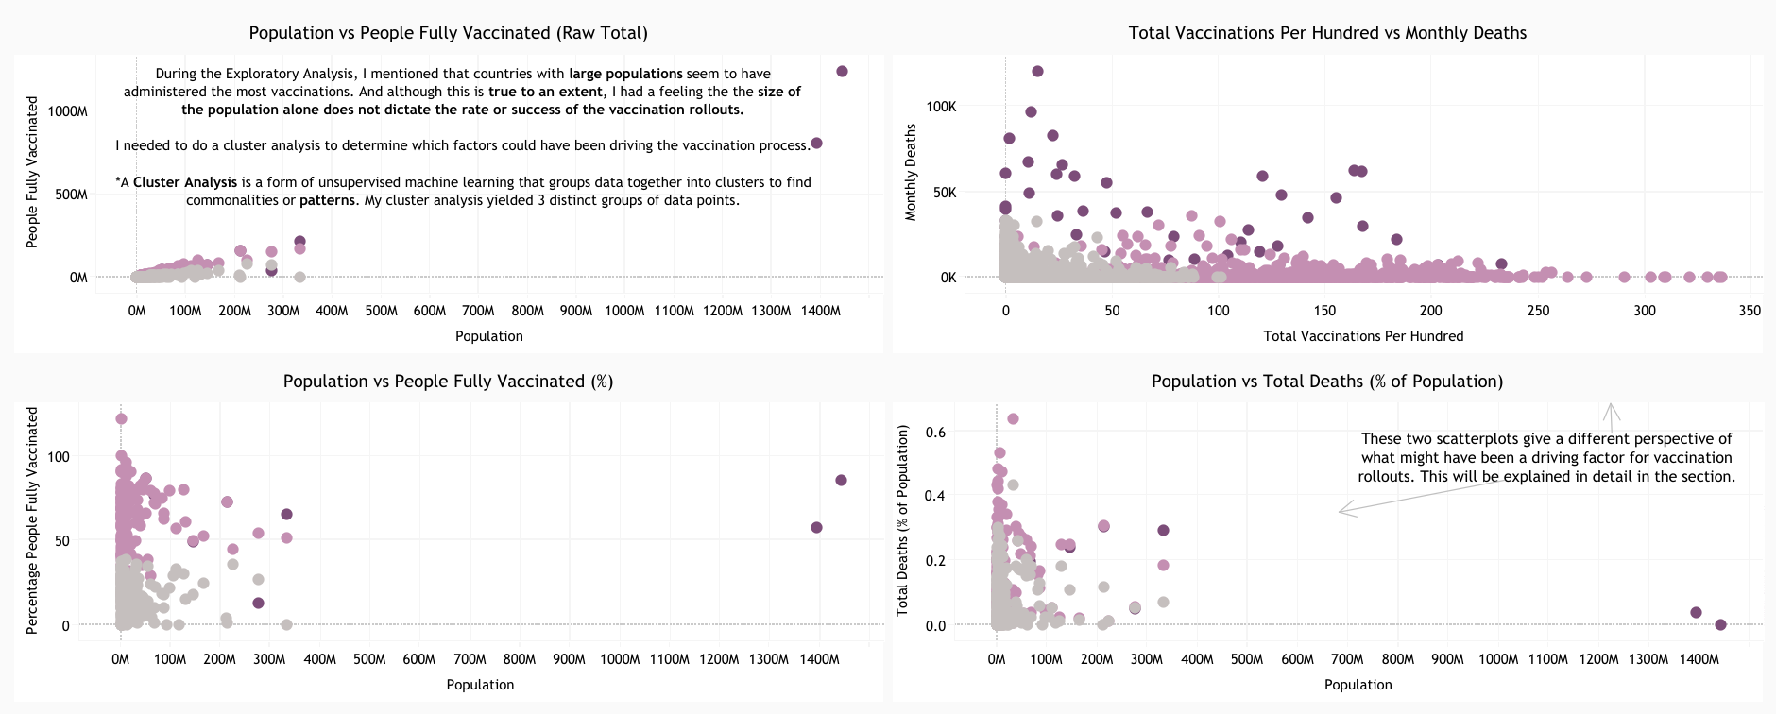
Cluster Analysis
ANALYSIS STEPS:
I first used the elbow technique to determine how many clusters there are. The elbow techniques yielded three distinct groups.
The 3 clusters were plotted on scatterplots using k-means clustering.

Slide 8




insights
32
Countries started with vaccination rollouts in 2020
Peru has the highest percentage of deaths
The African continent is far behind in the vaccination process
Severity, population size, development & education are all driving factors for vaccination progress

Slide 9
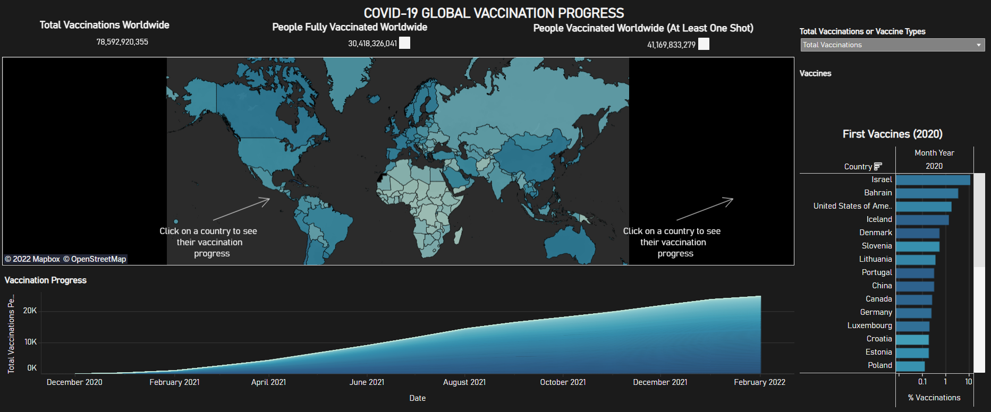
Tableau dashboard

Slide 10



Marilize de Villiers marilizedv@gmail.com
GitHub Repository
Vaccination Analysis Storyboard
Feel free to click on the following icons to see my Tableau Dashboards and Storyboards, as well as my python codes on GitHub and my LinkedIn profile.
Vaccination Operational Dashboard
LinkedIn Profile

